Slide 1

Gaming Analysis with SQL
Internship Project by Moamena Samir with Mentorness
Batch – MIP-DA-06

Slide 2

Content
About the Project
Dataset Description
Import the Data
Prepare and Modify the Data
Analysis SQL Problem Statement
What I learn

Slide 3
About the Project
In this internship, I was working with a dataset related to a game. The dataset includes two tables:
Level Details Table:
`P_ID`: Player ID
`Dev_ID`: Device ID
`start_time`: Start Time
`stages_crossed`: Stages Crossed
`level`: Game Level
`difficulty`: Difficulty Level
`kill_count`: Kill Count
`headshots_count`: Headshots Count `score`: Player Score
`lives_earned`: Extra Lives Earned
Player Details Table:
`P_ID`: Player ID
`PName`: Player Name
`L1_status`: Level 1 Status
`L2_status`: Level 2 Status
`L1_code`: System generated Level 1 Code
`L2_code`: System generated Level 2 Code

Slide 4
Dataset Description
Players play a game divided into 3-levels (L0,L1 and L2)
Each level has 3 difficulty levels (Low, Medium, High)
At each level, players must kill the opponents using guns/physical fight
Each level has multiple stages at each difficulty level.
A player can only play L1 using its system generated L1_code.
Only players who have played Level1 can possibly play Level2
using its system generated L2_code.
By default, a player can play L0.
Each player can login to the game using a Dev_ID.
Players can earn extra lives at each stage in a level.

Slide 5
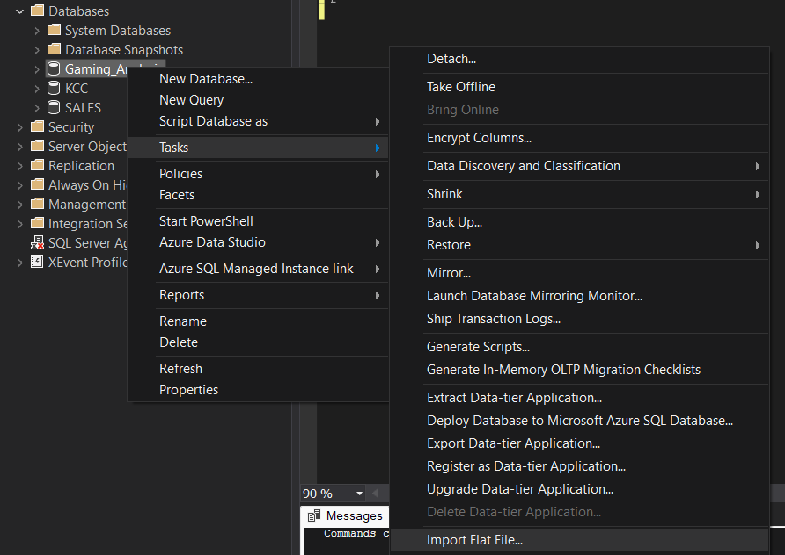
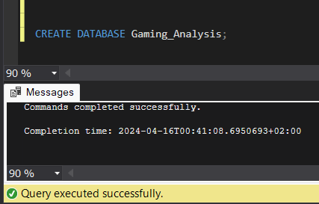
Import the Data
Create Database
Import as flat file

Slide 6
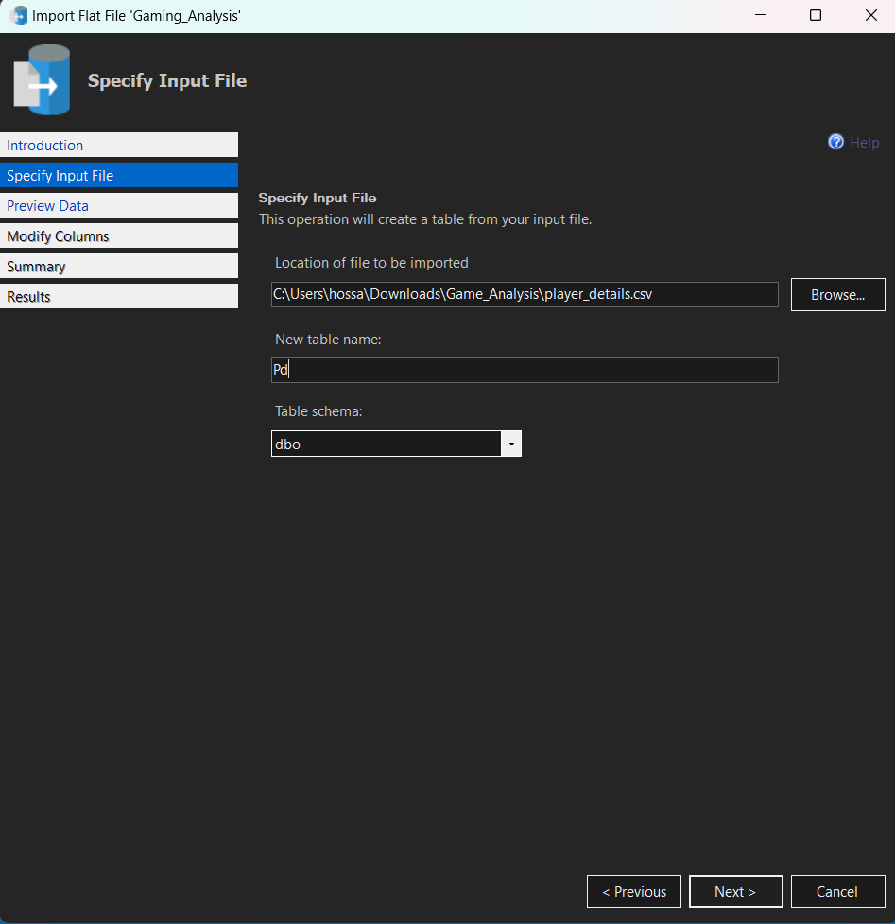
Import the Data
Brows the File

Slide 7
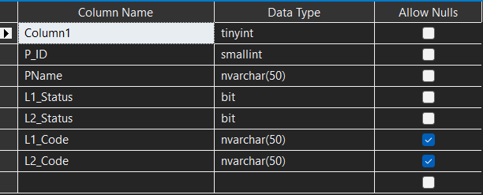
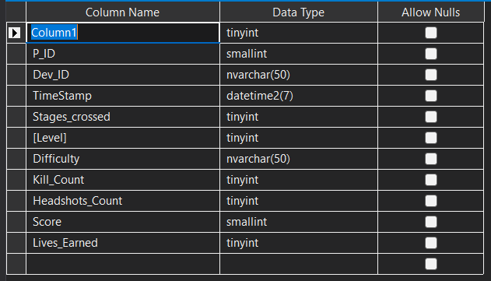
Prepare and Modify the Data
TASKS:
Delete Column1
Change Datatype for L1_Status and L1_Status to varchar(30)
Change Datatype for P_ID to int primary key
Tasks:
Delete Column1
Change Column name for TimeStamp to Start_datetime and datatype to datetime
Change Datatype for P_ID, Dev_ID, and Start_datatime to primary key
Change Datatype for Dev_ID to varchar(10)
Change Datatype for Difficulty to varchar(15)

Slide 8
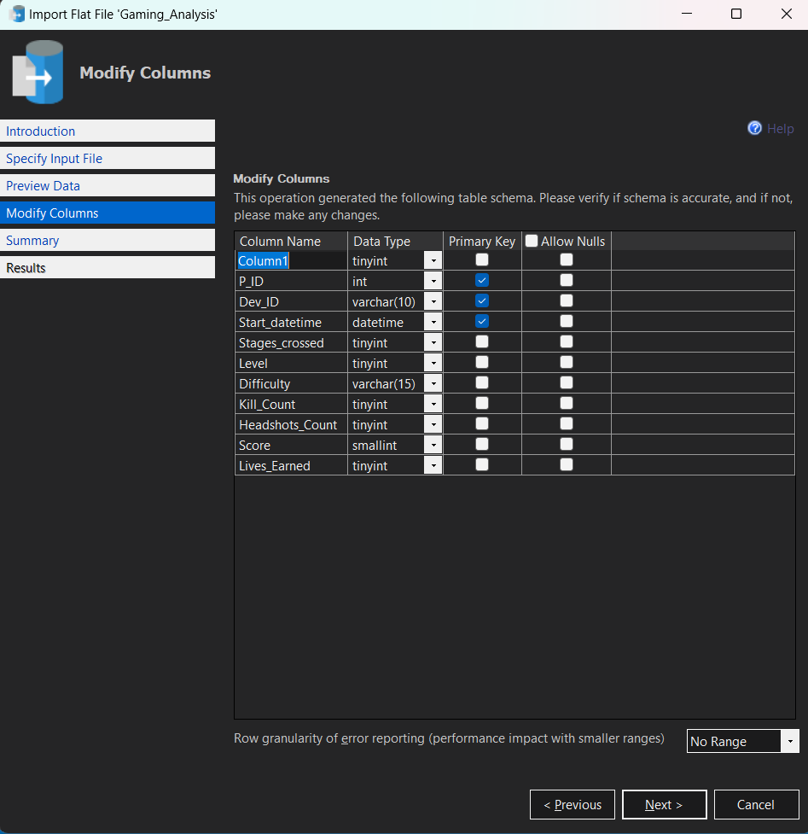
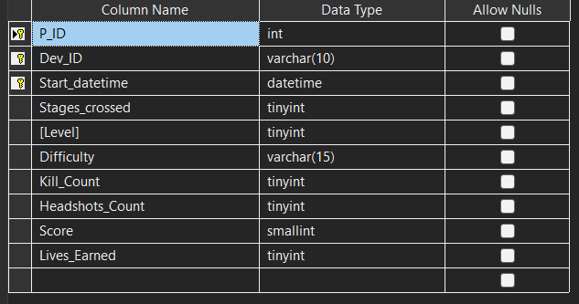
Modify the Data in Drop down meun

Slide 9
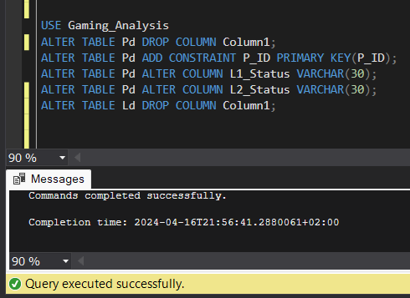
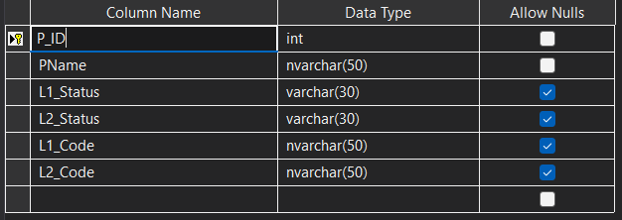
Modify the Data in SQL Queries

Slide 10
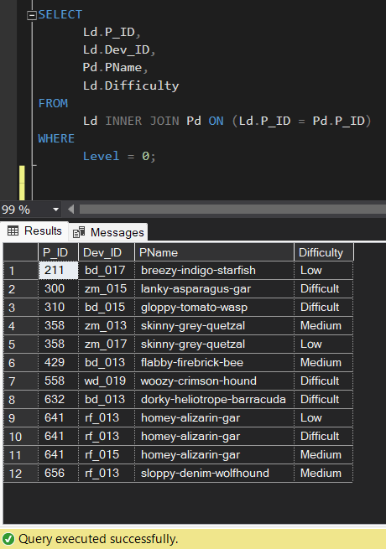
Analysis SQL Problem Statement
1) Extract `P_ID`, `Dev_ID`, `PName`, and `Difficulty_level` of all players at Level 0.
What I use?
Inner Join
Why?
To combine records from two tables whenever there are matching values in a field common to both tables.

Slide 11
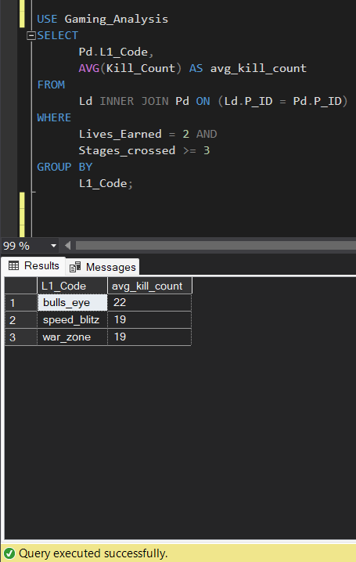
Analysis SQL Problem Statement
2) Find `Level1_code`wise average `Kill_Count` where `lives_earned` is 2, and at least 3 stages are crossed.
What I use?
Group By
Why?
Causes the rows of the items table to be collected into groups

Slide 12
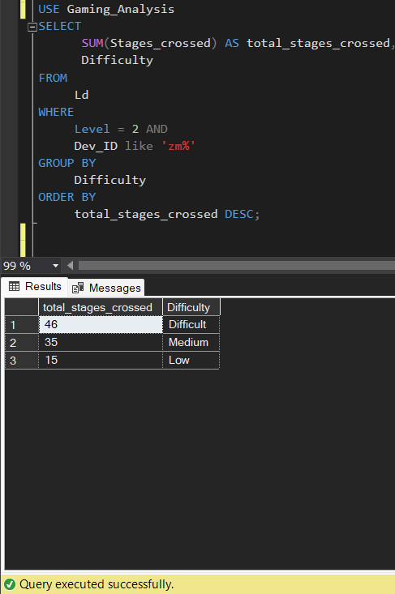
Analysis SQL Problem Statement
3) Find the total number of stages crossed at each difficulty level for Level 2 with players
using `zm_series` devices. Arrange the result in decreasing order of the total number of
stages crossed.
What I use?
Group By
Why?
Causes the rows of the items table to be collected into groups

Slide 13
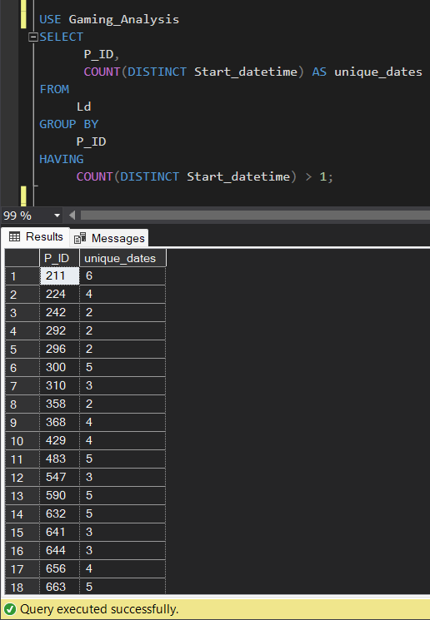
Analysis SQL Problem Statement
4) Extract `P_ID` and the total number of unique dates for those players who have played
games on multiple days.
What I use?
Having
Why?
It is used to filter records that one or more columns have grouped.
The HAVING clause is used instead of the WHERE clause with aggregate functions.

Slide 14
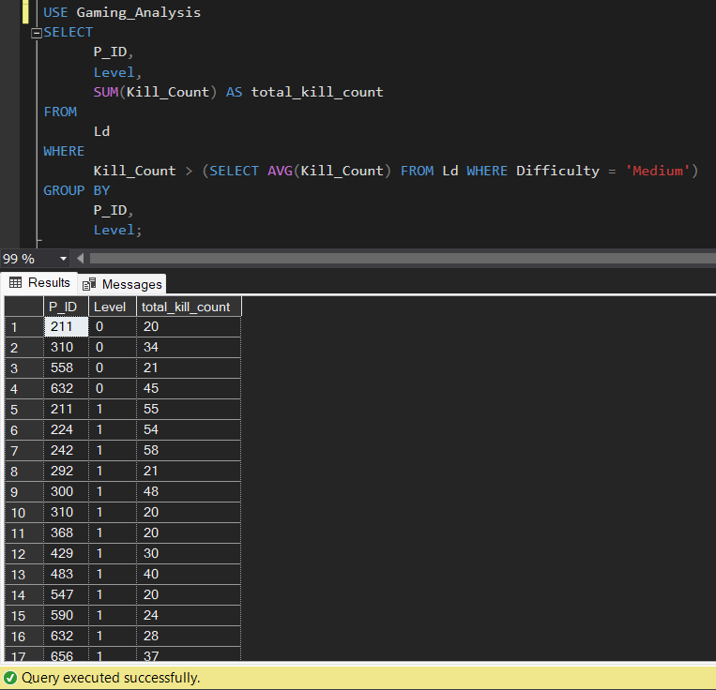
Analysis SQL Problem Statement
5) Find `P_ID` and levelwise sum of `kill_counts` where `kill_count` is greater than the average kill count for Medium difficulty.
What I use?
A nested query
Why?
Nested queries are a way to perform complex queries by embedding one query within another.
The outer query can apply some conditions on the results of the inner query

Slide 15
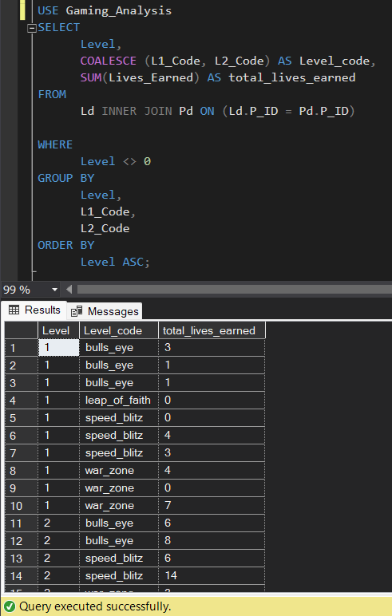
Analysis SQL Problem Statement
6) Find `Level` and its corresponding `Level_code`wise sum of lives earned, excluding Level 0. Arrange in ascending order of level.
What I use?
Coalesce
Why?
to return non-null values in a list

Slide 16
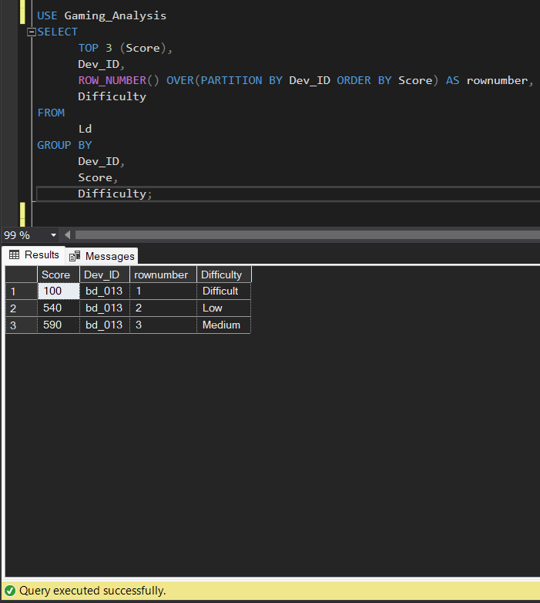
Analysis SQL Problem Statement
7) Find the top 3 scores based on each `Dev_ID` and rank them in increasing order using `Row_Number`. Display the difficulty as well.
What I use?
Row Number
Why?
To assigns a unique sequential number to each row in the result set of a query.

Slide 17
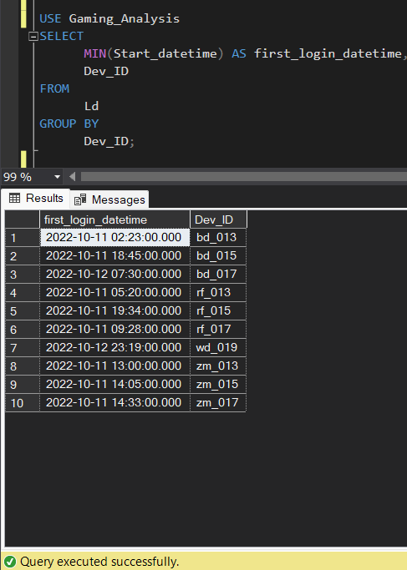
Analysis SQL Problem Statement
8) Find the `first_login` datetime for each device ID.
What I use?
Minimum function
Why?
To returns the smallest value of the selected column.

Slide 18
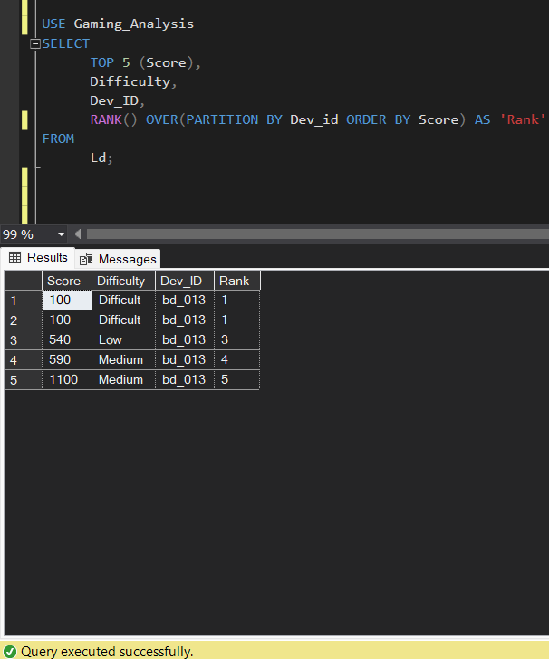
Analysis SQL Problem Statement
9) Find the top 5 scores based on each difficulty level and rank them in increasing order
using `Rank`. Display `Dev_ID` as well.
What I use?
Rank Function
Why?
To gives each row a rank according to a specific ordering.

Slide 19
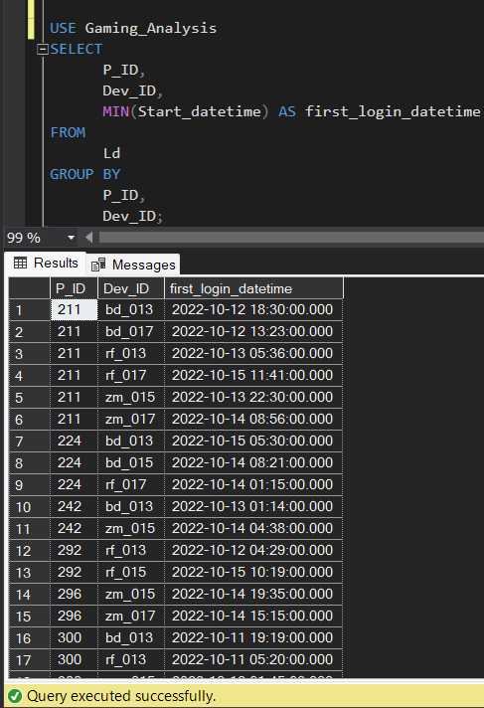
Analysis SQL Problem Statement
10) Find the device ID that is first logged in (based on `start_datetime`) for each player (`P_ID`). Output should contain player ID, device ID, and first login datetime.
What I use?
Minimum Function
Why?
To returns the smallest value of the selected column.

Slide 20
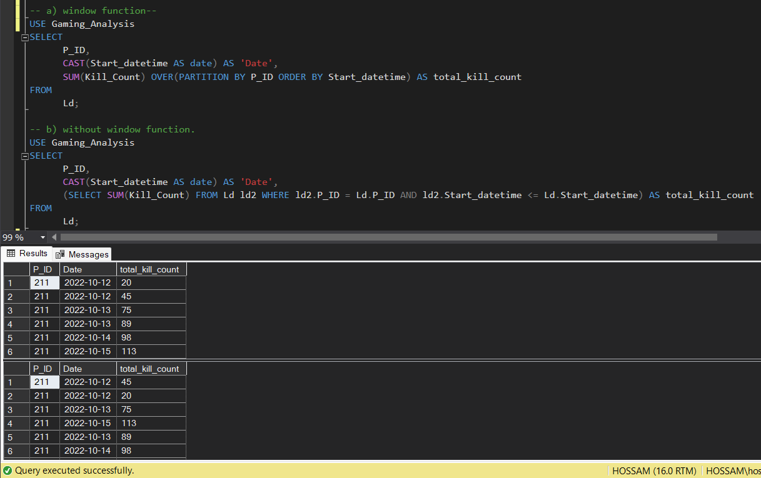
Analysis SQL Problem Statement
11) For each player and date, determine how many `kill_counts` were played by the player so far.
a) Using window functions
b) Without window functions
What I use?
Cast functions
window functions
Why?
CAST: A SQL function that converts data from one datatype to another.
Window functions are SQL operations that perform a calculation across a set of rows that are related to the current row.

Slide 21
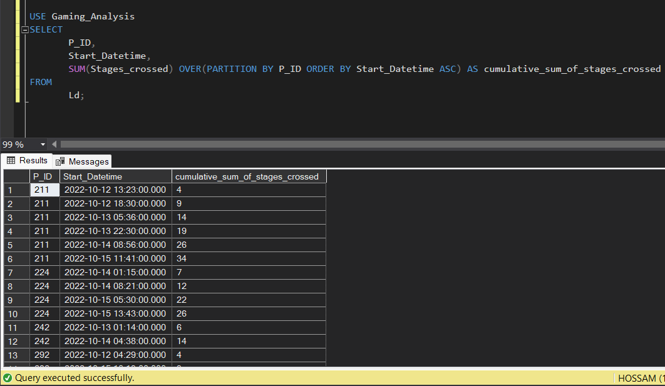
Analysis SQL Problem Statement
12) Find the cumulative sum of stages crossed over `start_datetime` for each `P_ID`, excluding the most recent `start_datetime`.
What I use?
Window functions
Why?
Window functions are SQL operations that perform a calculation across a set of rows that are related to the current row.

Slide 22
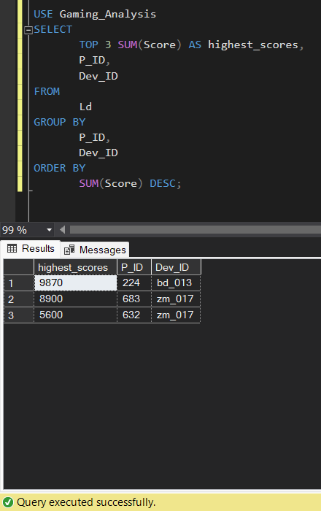
Analysis SQL Problem Statement
13) Extract the top 3 highest sums of scores for each `Dev_ID` and the corresponding `P_ID`.
What I use?
Top functions
Why?
allows limiting the number of records returned from a query, as well as displaying the number of highest/lowest rows, according to a certain condition.

Slide 23
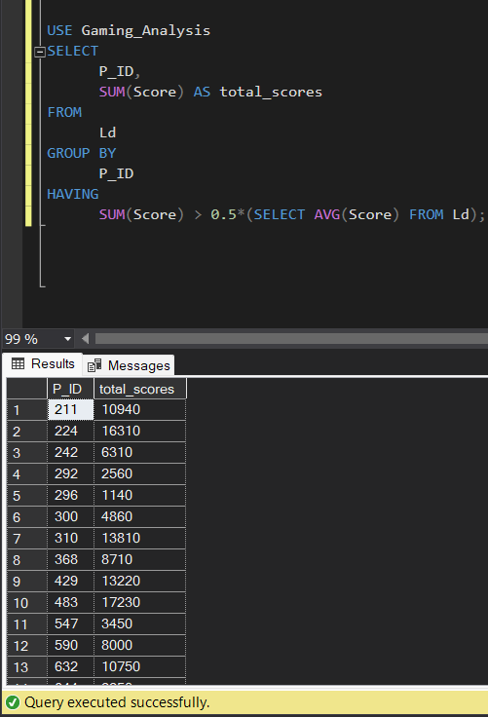
Analysis SQL Problem Statement
14) Find players who scored more than 50% of the average score, scored by the sum of scores for each `P_ID`.
What I use?
Having
Why?
It is used to filter records that one or more columns have grouped.
The HAVING clause is used instead of the WHERE clause with aggregate functions.

Slide 24
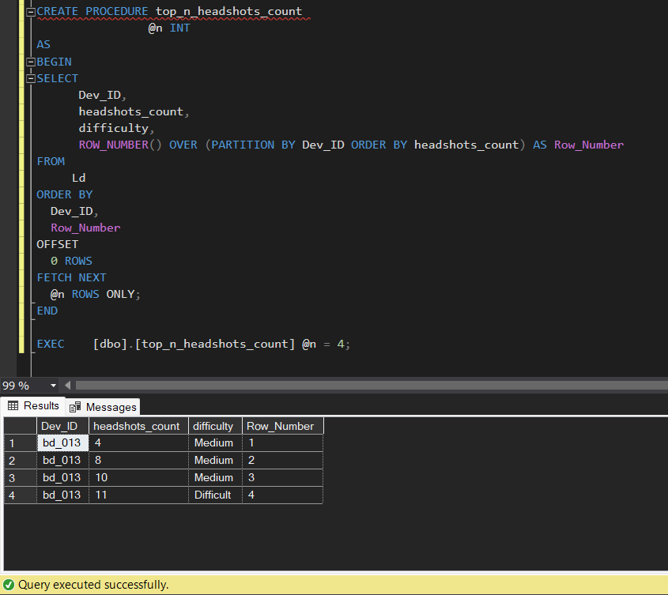
Analysis SQL Problem Statement
15) Create a stored procedure to find the top `n` `headshots_count` based on each `Dev_ID`and rank them in increasing order using `Row_Number`. Display the difficulty as well.
What I use?
OFFSET-FETCH clause
Why?
is used to return only the top @n rows of data. The OFFSET 0 ROWS and FETCH NEXT @n ROWS ONLY statements effectively limit the result set to the first @n rows.

Slide 25
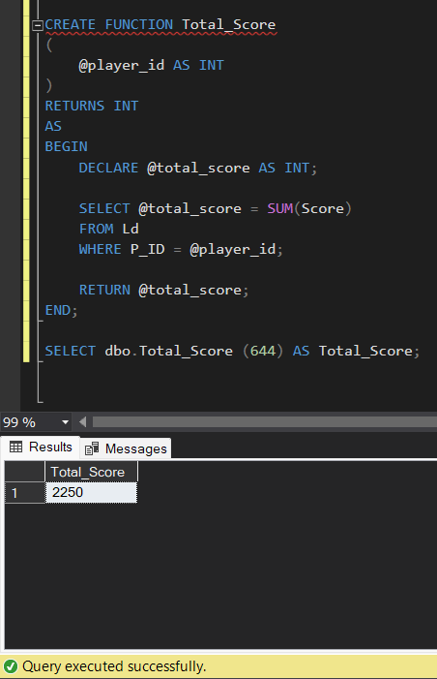
Analysis SQL Problem Statement
16) Create a function to return sum of Score for a given player_id.
What I use?
Declare
Why?
to create a variable that can store data temporarily during the execution of code.

Slide 26
What I learn
SQL Joins
SQL GROUP BY and HAVING Clause
A Nested Query
COALESCE and Cast Function
Row Number and Rank Function
Minimum and Top Function
SQL Declare Variable
OFFSET-FETCH clause
Source File: https://github.com/MoamenaSamir/Gaming-Data/blob/main/SQLQuery1.sql

Slide 27
Thank You

